Slide 1
Classifying and Grouping Products to Gain Marketing Knowledge
By : Your Name

Slide 2
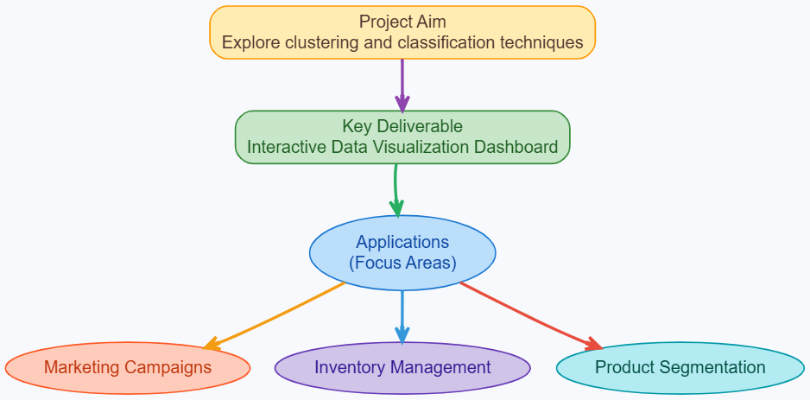
Overview of Project

Slide 3
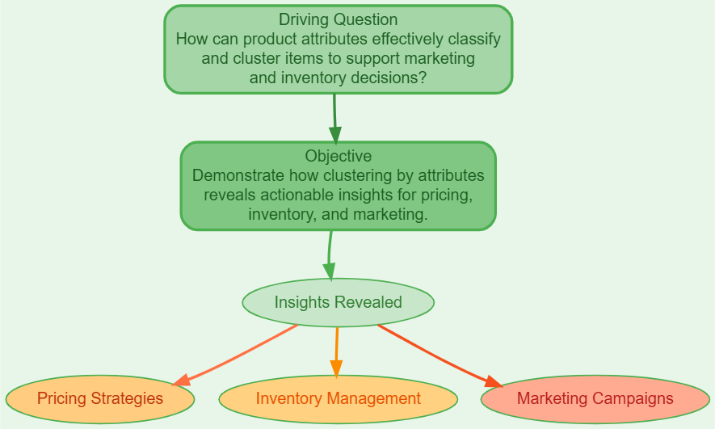
Driving Question

Slide 4
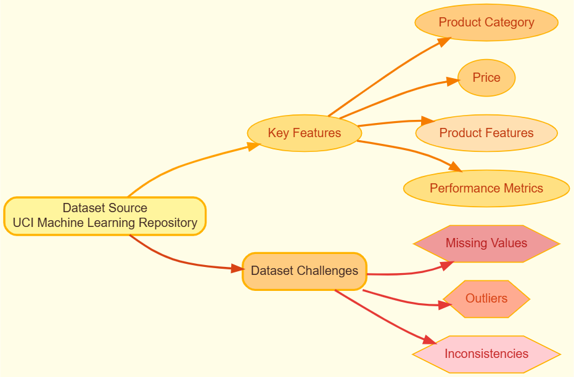
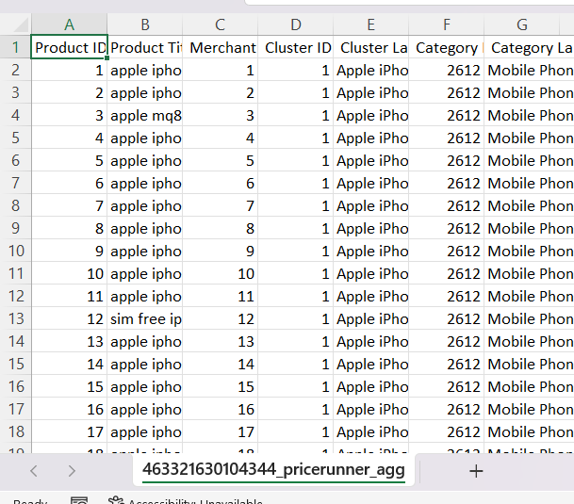
Overview of Dataset

Slide 5
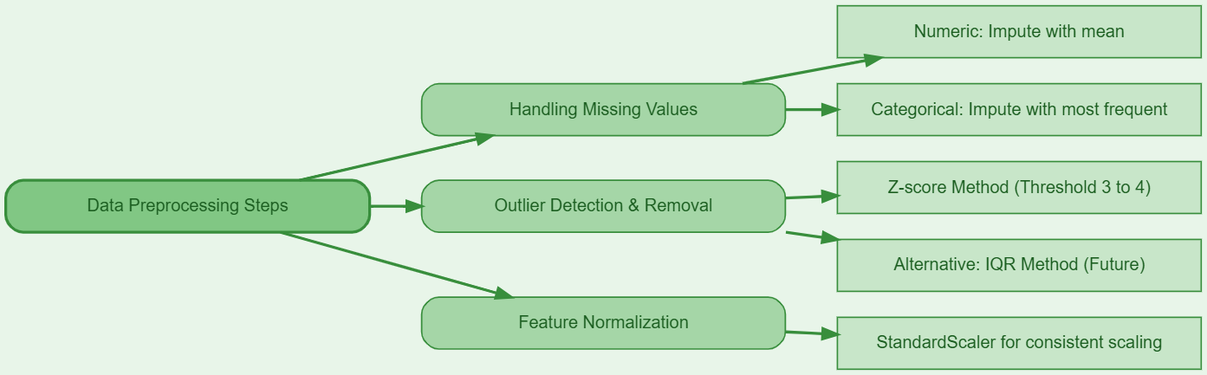
Data Preprocessing Steps

Slide 6
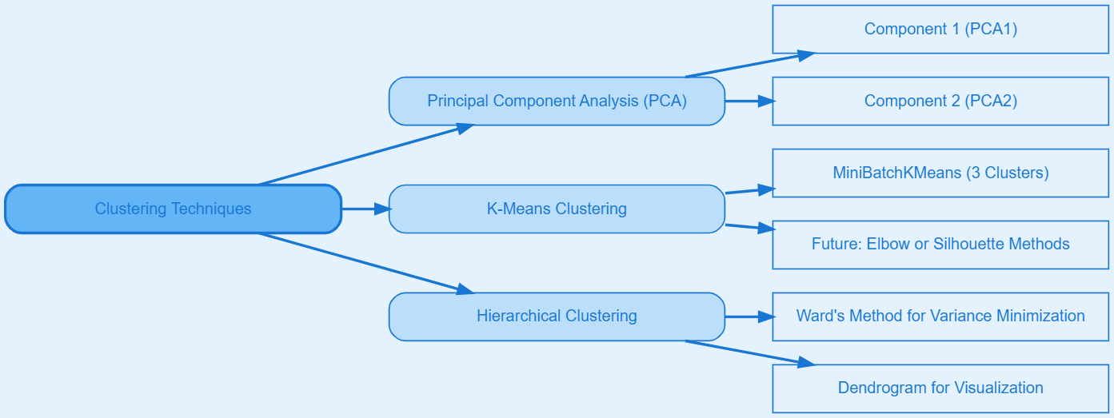
Clustering Techniques

Slide 7
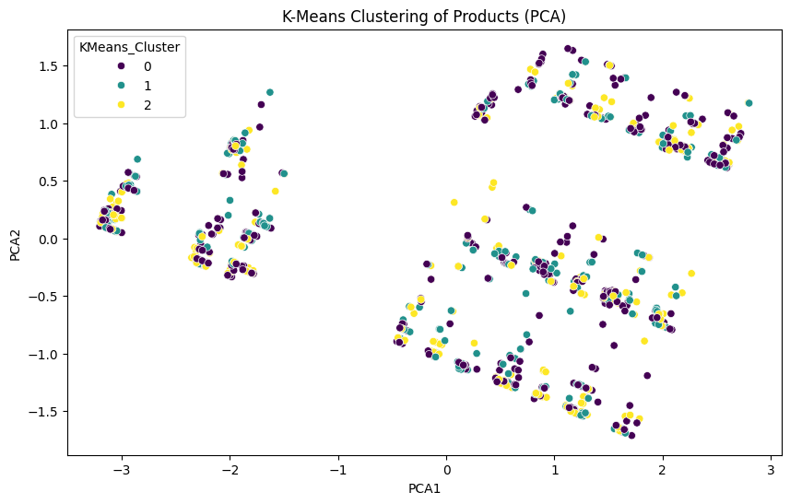
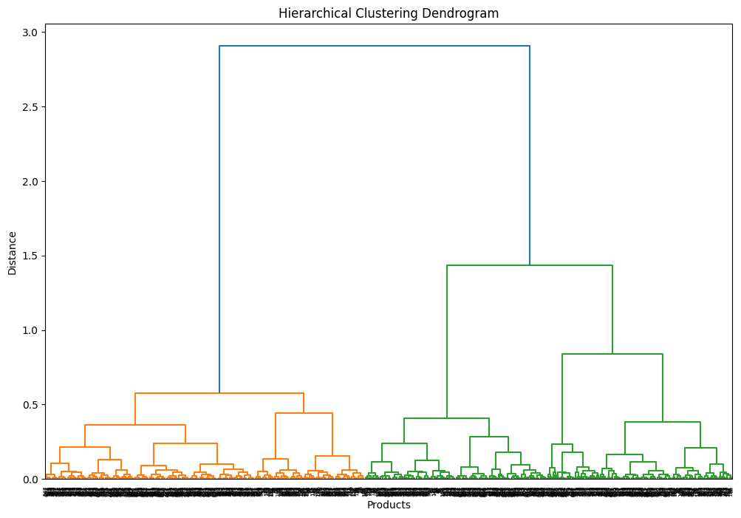

Slide 8
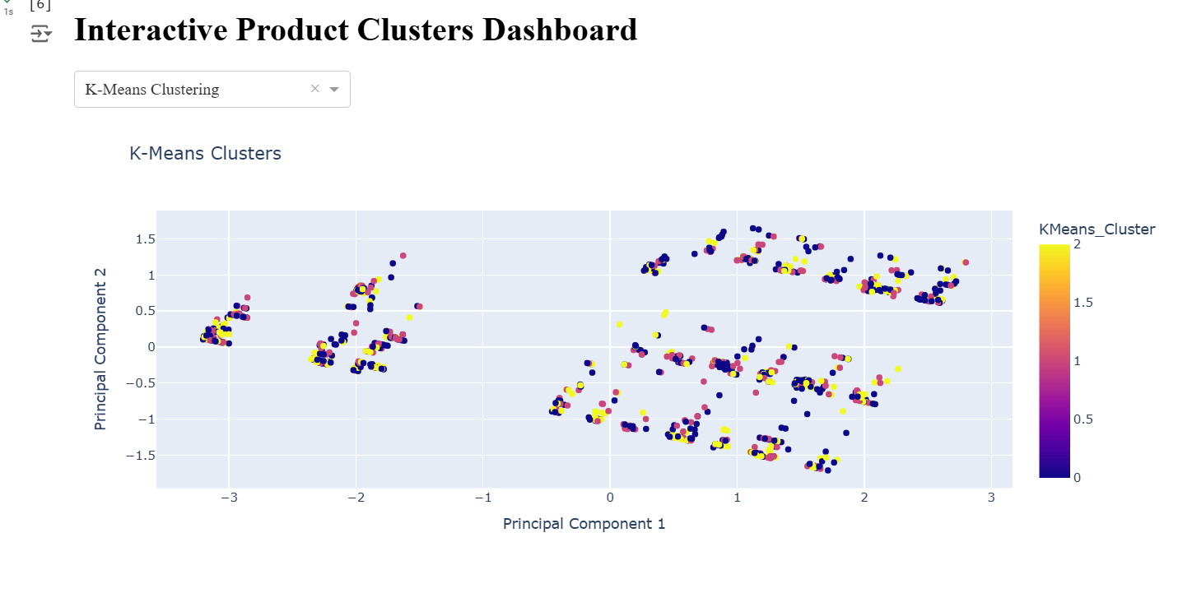
Interactive Dashboard

Slide 9
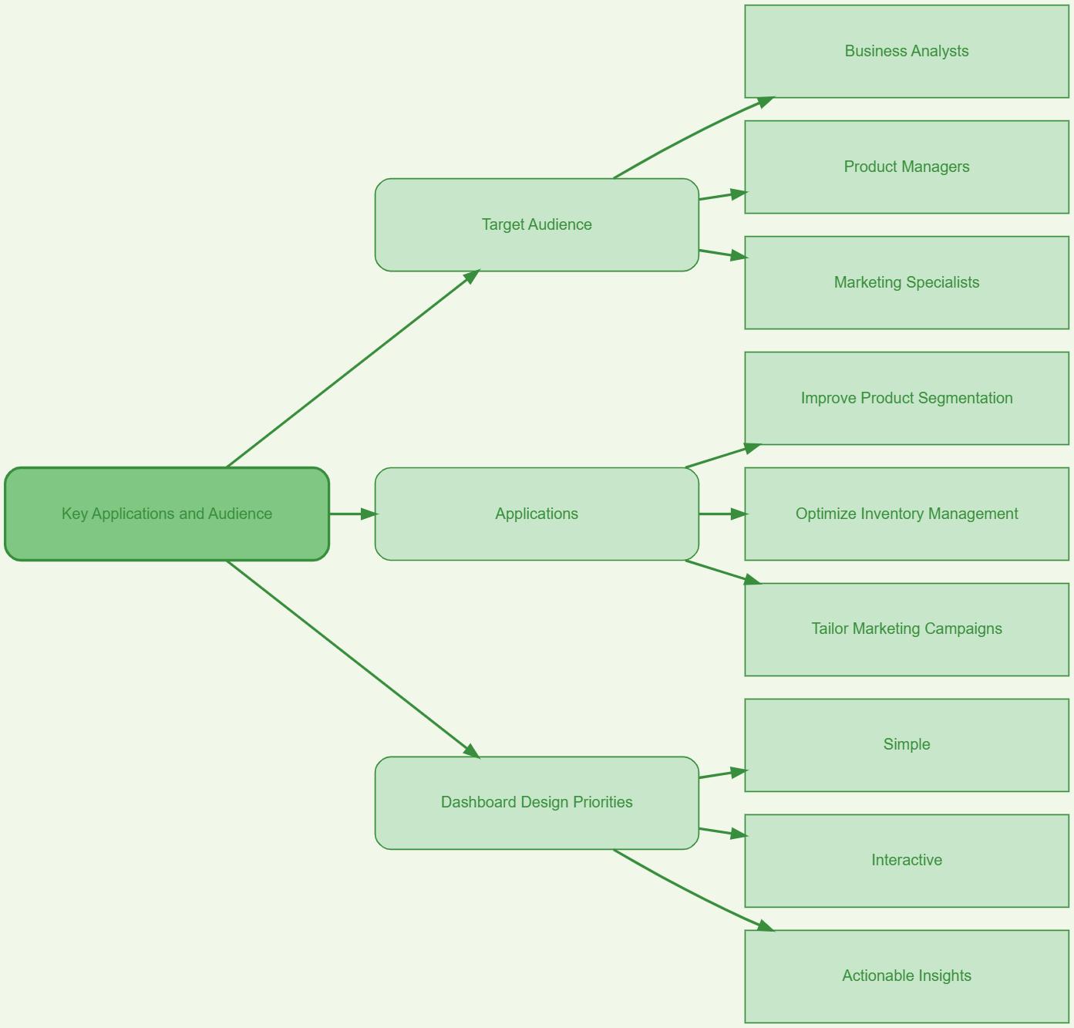
Key Applications and Audience

Slide 10
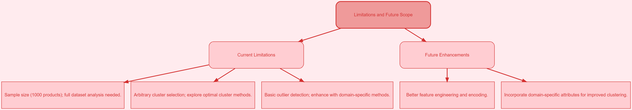
Limitations and Future Scope

Slide 11
Conclusion
In brief:
Techniques for classification and clustering give companies useful information for enhancing their product strategy.
By making it simple for decision-makers to see product trends and patterns, interactive dashboards empower them.
Principal Advantages:
product segmentation-based marketing techniques that are optimized.
improved inventory control through the discovery of product groups.
improved product creation based on insights from data.
An Appeal for Action:
Make wise business decisions by using machine learning to find untapped opportunities.
To enhance product strategies, apply classification and clustering techniques to decision-making procedures.

Slide 12
THANK YOU !!!!!!!!!!!!!!!

